Slide 1
welcome
TO our presentation

Slide 2
INTRODUCTION TO COMPUTER STUDIES

Slide 3
Group members name :
1. RAHMAN MD. ASSIQUR - 19-40375-1
2. MD.EMRUL HASAN EMON - 19-40357-1
3ABIR MD. ASRAFUZZAMAN - 19-40356-1
4. ZAMIL AHMAD - 19-40400-1
5. TOFAYET SULTAN - 19-40385-1

Slide 4
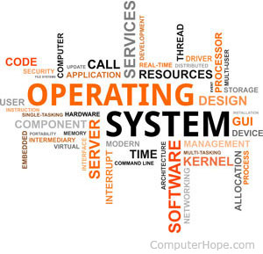
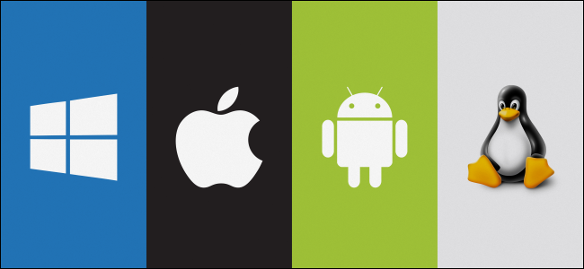
Topic name : Operating System

Slide 5
RAHMAN MD ASSIQUR:19-40375-1
We will present this presentation in some parts like:
Introduction
Types of OS.
Functions and components of OS.
Process and a program.
conclusion

Slide 6
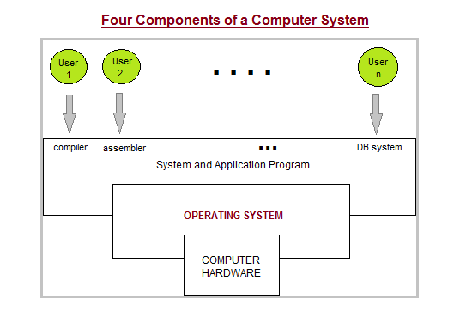
Introduction :
What is Operating System.
Views of operating system:
(Two Views of Operating System : 1User's View
2 System View)
Operating System Management Tasks :
Functions of Operating System :
Types of Operating Systems

Slide 7
2. MD.EMRUL HASAN EMON :-19-40357-1
Available And Types Of Operating System :
Some common operating system
1.Mac OSX
2.Linux
3.windows
4.Android
5.IOS

Slide 8
Different types of operating system :
1.Real time operating system
Example : OS 9,Symbian,Windows,CE,Lyns OX
2.Muiti user & single user operating system
Example : Windows 95,Windows 2000,Plam OS,Mac OS
3.Multi tasking & single tasking operating system
Example : Windows 9X,DOS Plus
4.Distributed operating system
Example : Amoeba, Plan9,LOCUS.

Slide 9
5.Mobile operating system
Example : Black berry OS,Googles,Android,Apples IOS
6.Embedded operating system
Example : Windows CE,Free BSD,Minix 3
7.Network operating system
Example : Microsoft Windows Server 2003,Microsoft Windows Server 2008,UNIX,Linux,BSD

Slide 10
3ABIR MD. ASRAFUZZAMAN - 19-40356-1
Function and Component of OS Functions of OS :
• Providing a user interface
• Running application
• Support for built in utility programs.
• Control to the computer hardware

Slide 11
Components of OS:
• Process Management
• Memory management
• Network management
• Network service
• User Interface

Slide 12
4. ZAMIL AHMAD :- 19-40400-1
PROCESS & A PROGRAM :
Process : In computing, a process is the instance of a computer program that is being executed. It contains the program code and its activity. Depending on the operating system (OS), a process may be made up of multiple threads of execution that execute instructions concurrently.
Program : A computer program is usually written by a computer programmer in a programming language. Alternatively, a computer program may be executed with the aid of an interpreter.

Slide 13
Features of operating system :
GUI
MULTIUSER
MULTITASKING
MULTIPROCESSING
MULTITHREADING

Slide 14
5. TOFAYET SULTAN - 19-40385-1
Main point(2):different views of operating system (1)users view
(2)system view
Operating system goals :1.convenience for the computer user
2. efficient operation of the computer system

Slide 15
Usefulness and effect (2): 1.advantage
2. Disadvantage

Slide 16
THANK YOU
EVERYONE

